Slide 1
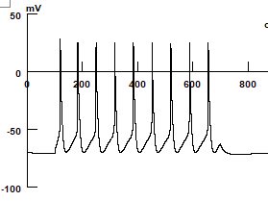
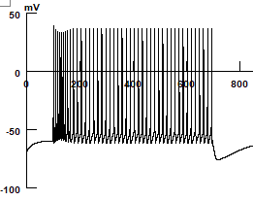
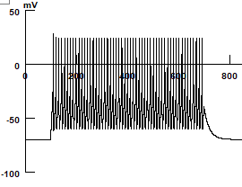
- 1000-cell model with the following cell numbers: 800 Cortico-Pontine (CP) PNs, 100 PVs and 100 SOM cells
Cortico-Pontine PN
SOM
PV
ms
ms
ms
300pA
300pA
300pA
L=270um
L=250um
L=150um
L=555um
L=250um

Slide 2
- Connectivity majorly relies on info that Drew provided
5
6
2
4
CP->CP : 10% of pairs are unidirectional, out of them 30% are reciprocal
2&3. CP->PV : 20% of pairs are unidirectional, 30% are reciprocal, and they are counted for 3. PV->CP
4. PV->PV: 34% of pairs are unidirectional, 43% are reciprocal
5. SOM->CP: 26/74 of pairs are unidirectional, and 13/74 of pairs are reciprocal, Beierlein et al 2003
6. CP->SOM: 36/63 of pairs are unidirectional. Beierlein et al 2003
7&8. 17/32 of pairs are unidirectional in SOM->PV, 11/32 are unidirectional in PV->SOM, and 7/32 of pairs are reciprocal, Gibson et al 1999
3
1
8
7

Slide 3
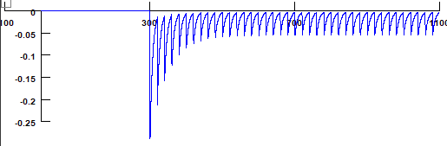
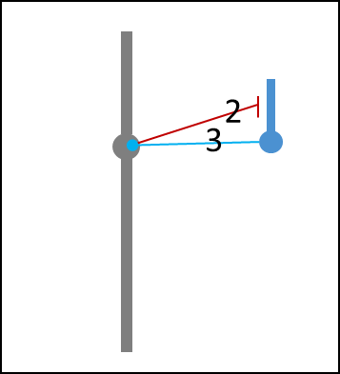
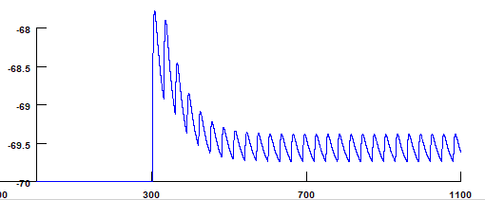
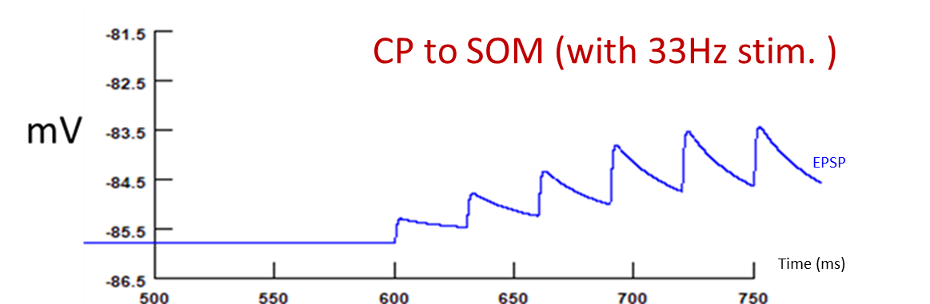
Short term plasticity
PV to CP (with 50Hz stim.)
Time (ms)
nA
Gaba current
PV-CP and CP-PV and synapses have short-term depression,
CP-SOM synapses show short-term facilitation
CP to PV (with 67Hz stim.)
mV
EPSP
Time (ms)
6

Slide 4
Network Results
Baseline extrinsic inputs at 2 Hz result in the following firing rates: mean± std
CP: 0.54±0.28, PVs: 2.81±1.06, SOMs: 1.22±0.2 Hz

Slide 5
Network Results
2. To the baseline model we add extrinsic inputs with burst style at 50 Hz to 1/8 (100 cells) of the CP cells.
We designed two types of bursts, one called short burst and another one is long burst. Schematic plots for burst is displayed as below:
Baseline
Baseline simulation means, just feed 2Hz random Possion input to each CPs
Short burst simulation means
...
Baseline
Indicates 20% of the CPs get additional independent
Possion input at 50Hz during defined time window.
200ms
500ms
Long burst simulation
...
Baseline
1000ms
500ms

Slide 6
Network Results-FR
3. Additional short/long burst extrinsic inputs at 50 Hz result in the following firing rates (calculated over entire simulation time, regardless of burst or baseline) :
Short burst input
Long burst input
CP: 1.16±1.87, PVs: 4.51±2.37,
SOMs: 10.7±0.9 Hz
CP: 2±4.18, PVs: 4.65±2.55,
SOMs: 22.96±1.8 Hz

Slide 7
Network Results-PSD
baseline
Short burst input
Long burst input
Spectrum residue from 1/f
10
100
10
100
10
100
Hz
Hz
Hz
4. It is clear that, short burst input would generate prominent gamma oscillation, while long burst suppresses gamma but enhance beta oscillation.

Slide 8
What I have
Voltage (mv)
Time (ms)

Slide 9
STP ON
STP off for between PN and PV
STP off for P2SOM
STP off for all conns

Slide 10
Raster plot
LTS
PV
PN
CELL ID
Time (ms)

Slide 11
No PN-PN
No STP
LTS
PV
PN
CELL ID
Time (ms)
Time (ms)

Slide 12
No afferents drive, no PN->PV or PN->PV
Decrease PN-PN wgt
LTS
PV
CELL ID
PN
CELL ID
PN
No afferents drive, no PN->PV or PN->PV
PN
CELL ID

Slide 13
Inherent frequency of the afferent
Beta
Gamma
Short burst afferent
Resting for 500 ms
1/f residue
Change ensemble of 80 CPs every 100 ms
Long burst afferent
Resting for 500 ms
Using the same ensemble of 80 CPs for 1000 ms
Hz

Slide 14
Afferent burst rate=25Hz
Inherent frequency of the afferent
Afferent burst rate=50Hz
Beta
Gamma
1/f residue
Hz
Hz

Slide 15
Inherent frequency of the afferent
Fixed duration of afferents at 100ms
Beta
Gamma
1/f residue
Jittered duration of afferents from 80 to 120ms
Jittered duration of afferents from 40 to 160ms
Hz
1/f residue
Hz
Hz

Slide 16
Short burst always impinges on the same ensemble
1/f residue
Hz

Slide 17
Raster plot
LTS
PV
PN
CELL ID
Time (ms)

